Slide 1

Jaivik Setu
BRIDGING NATURAL FARMERS AND CONSCIOUS CONSUMERS
Janvi Chauhan, Team Manager & Backend Developer
Ansh Yadav, Full Stack Developer
Tirth Gohel, Frontend Developer
Tej Doshi, Backend Developer

Slide 2
AGENDA
Problem
Solutions
Market Size
Tech Stack
UI / UX
Go-To-Market

Slide 3

PROBLEM
Farmer Challenges:
Struggle to find reliable buyers.
Dependence on middlemen reduces profits.
Limited market access for natural farming products.
Consumer Challenges:
Difficulty in verifying genuine organic products.
Misinformation due to fake organic labels.
Trust issues in the organic market.
Lack of Transparency:
No direct connection between farmers and consumers.
Unstructured market with unverified product claims.
Market Implications:
Middlemen increase costs for consumers.
Genuine organic practices are overshadowed by commercial products using pesticides and insecticides.
Consumer confidence weakened by non-transparent systems.
Ingoude Company

Slide 4
SOLUTION
Direct Farmer-to-Consumer Connection:
Platform connects certified natural farmers with conscious consumers.
Farmer Verification Process:
Registration with farm details & contact information.
Submission of identity proofs, land records, and organic certifications.
On-site third-party inspections for soil health, water management, and sustainable practices.
Admin review & digital certification issued within 48 hours.
QR Code Traceability:
Each product gets a unique QR code linking to its origin, farming methods, and certification details for real-time authenticity verification.
Elimination of Middlemen & Fair Pricing:
Direct selling marketplace ensures fair pricing for farmers and cost savings for consumers.
Transparent pricing displayed, highlighting the benefits of bypassing intermediaries.
Ingoude Company

Slide 5

MARKET SIZE
TAM
21.6 lakh
Valued at approximately ₹21.6 lakh crore in 2024, with a projected Compound Annual Growth Rate (CAGR) of 20(13% from 2025 to 2033. imarcgroup.com
SAM
Indian Organic Food Market of estimated at ₹15,917 crore in 2024, expected to reach ₹90,437 crore by 2034, growing at a CAGR of 22% during 2025-2034. expertmarketresearch.com
15,917 cr
SOM
Aiming to secure 2% of the Indian organic food market within the first three years, translating to approximately ₹1,808 crore in revenue.
1,808 cr
Ingoude Company

Slide 6
TECH STACK
Frontend (Nextjs)
UI components:
shadcn/ui
react-bits
Animations:
framer motion
Forms & Validation:
yup & react-hook-form
State Management:
zustand
Performance:
next/bundle-analysis
Progressive web apps:
next-pwa
Backend (Django)
REST api:
Django REST Framework (DRF)
Authentications:
JSON web token (JWT)
Cors protection:
Django-CORS-Headers
Ingoude Company

Slide 7
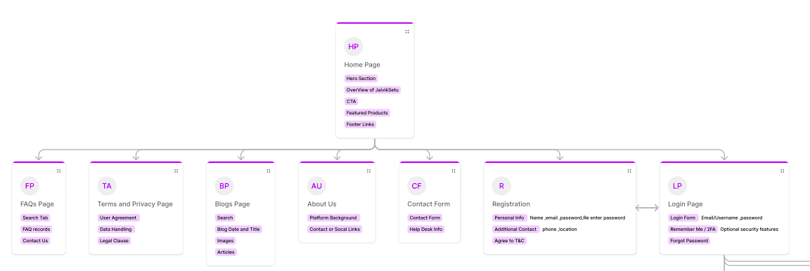
UI / UX
A sitemap visually represents the website’s structure, showing page relationships for easy navigation and organization.
Click here to view the complete sitemap.
Ingoude Company

Slide 8
GO-TO-MARKET
Transaction Fees on Sales (Marketplace Model)
Subscription Plans for Farmers & Retailers
QR Code & Certification Services
Data & Insights for Businesses
Sponsored Listings & Ads
Ingoude Company

Slide 9
Thank you!
JAIVIK SETU
Click to view sitemap.
Click to view documentation.
Janvi Chauhan, Team Manager & Backend Developer
Ansh Yadav, Full Stack Developer
Tirth Gohel, Frontend Developer
Tej Doshi, Backend Developer
Ingoude Company

